Slide 1

My data comes from Kaggle. https://www.kaggle.com/datasets/adityak2003/college-basketball-players-20092021?select=CollegeBasketballPlayers2009-2021.csvWhat is the most interesting part about your data?
(1) Stats of U.S men’s college basketball from 2009-2021.
(2) NBA draft results from 2009-2021
Most Interesting thing
I can track the player’s college stats and his draft result, so as to explore the relationship between them.
Tianyi Xiong
uniqname: xiongty
Database Name:
college_basketball

Slide 2
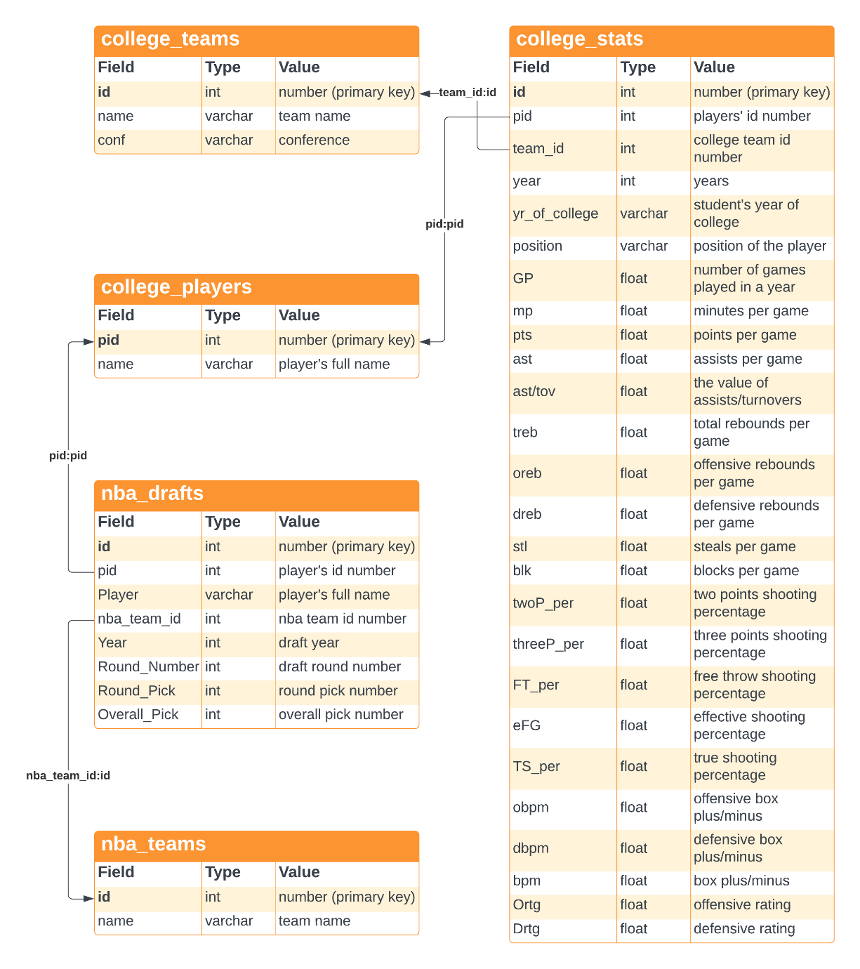
Most Complex Thing
Connect nba_drafts.pid to college_players.pid
Diagram

Slide 3
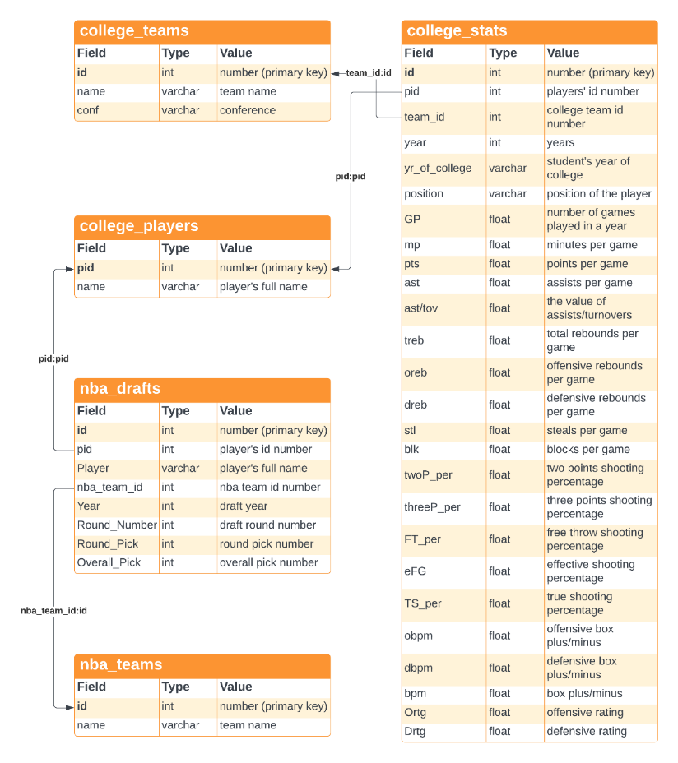
Most Complex Thing
Connect nba_drafts.pid to college_players.pid
Diagram
Connect nba_drafts.pid to college_players.pid
Since there are players with different pids but have same names, I need to join the tables with college_stats by the corresponding draft year, so as to avoid choosing the wrong player.
The pids of international players and those who didn’t go to college are NULL.

Slide 4
I want to compare the top 3 pick players’ advanced stats (True shooting percentage, box plus minus, offensive box plus minus, defensive box plus minus) with the average stats and max stats in his draft year. Could you give me a list of all these stats from 2009-2021? I want the average and max data of those main players of each team, so please only choose those who played more than 10 games a year and played more than 20 minutes per game.
Step1: create a temp table to store the stats of all top 3 picked college players
create table temp1 as (select cp.name, cs.year, cs.TS_per, cs.bpm, cs.obpm, cs.dbpm from college_stats cs join college_players cp on cs.pid = cp.pid join nba_drafts nd on nd.pid = cp.pid where cp.pid in (select pid from nba_drafts where Overall_Pick<=3) and nd.Year = cs.year order by cs.year);
Favorite Question
Step2: create another temp table to store the average and max stats each year
create table temp2 as (select year, round(avg(TS_per), 2) as avg_TS_per, max(TS_per) as max_TS_per, round(avg(bpm), 2) as avg_bpm, max(bpm) as max_bpm, round(avg(obpm), 2) as avg_obpm,max(obpm) as max_obpm, round(avg(dbpm), 2) as avg_dbpm, max(dbpm) as max_dbpm from college_stats where GP > 10 and mp > 20 group by year);
Step3: join two temp tables to show the data in one list
select t1.name, t1.year, t1.Ts_per, t2.avg_Ts_per, t2.max_Ts_per, t1.bpm, t2.avg_bpm, t2.max_bpm, t1.obpm, t2.avg_obpm, t2.max_obpm, t1.dbpm, t2.avg_dbpm, t2.max_dbpm from temp1 t1 join temp2 t2 on t1.year = t2.year;

Slide 5
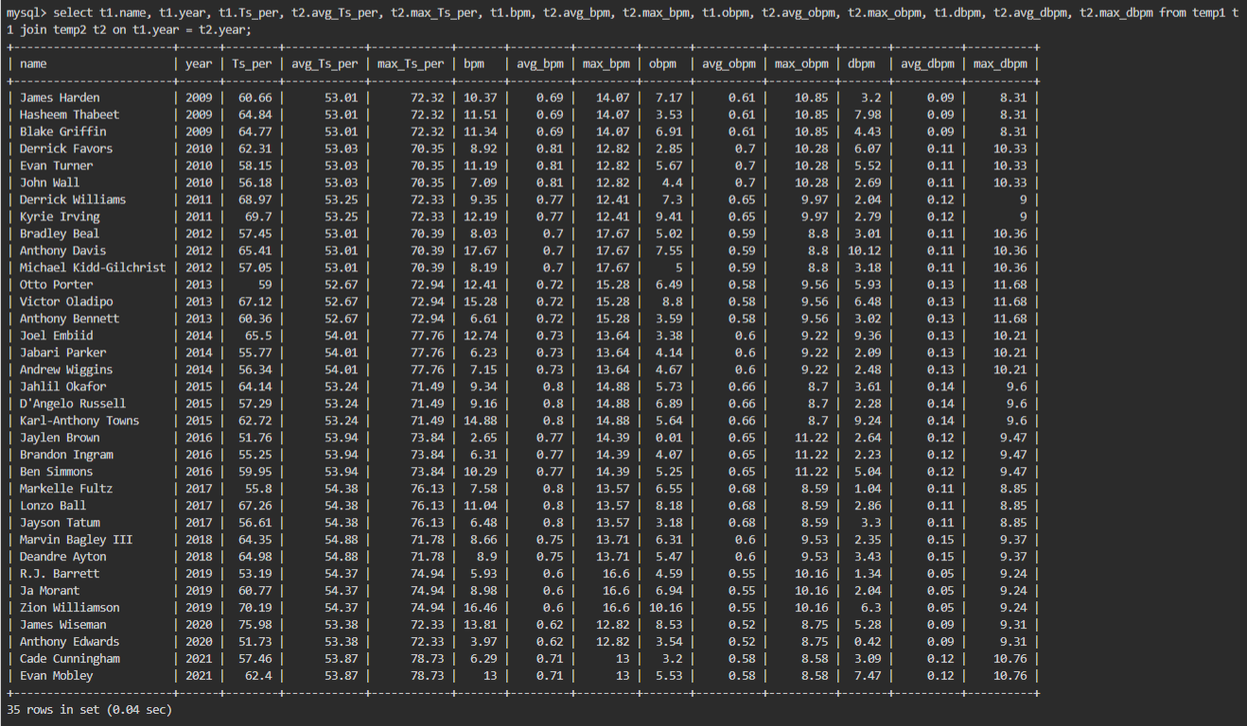
Favorite Question

Slide 6
If I have more time…
Fix the unmatched names (e.g. “J.R” & “J.R.” )
Import the dataset of NBA player’s stats from 2009-2021
track the college players’ performance in the NBA

